Slide 1
207 Remote: Introduction to Family Group Decision Making (FGDM): Part I

Slide 2
Section I: Welcome and Introductions

Slide 3
Agenda
Welcome and Introductions
What is Family Group Decision Making?
Family Group Decision Making Values, Beliefs, and Benefits
The Family Group Decision Making Process
Wrap-Up and Evaluation

Slide 4
Learning Objectives
Participants will be able to:
Describe the Family Group Decision Making (FGDM) process
Identify values and beliefs that drive the FGDM process
Identify concepts involved in the FGDM referral process
Competency
207-4: The Child Welfare Professional can use assessment data to collaboratively develop an appropriate, culturally competent case plan with the family, and can develop and link supportive family and community resources

Slide 5
Introductory Exercise
What is your name?
What is your occupation?
What county/agency do you represent?
Share one interesting fact about you or your family.
Share whether you referred a family to/attended/coordinated/facilitated a Family Group Decision Making meeting?
Share what you want to get from this training (What’s In It for Me?)

Slide 6
Section II: What is Family Group Decision Making?

Slide 7
Bean Exercise Questions
Has anyone in your immediate and/or extended family ever:
Had a teenager that was unruly or participating in unsafe activities?
Gone a little overboard disciplining their children, especially in public?
Left a child in the car while going into the corner store?
Had a younger child with an unexplainable bruise or injury?
Had difficulty parenting their child?
Been overwhelmed with trying to take care of their children?

Slide 8
Bean Exercise Questions
Has anyone in your immediate and/or extended family ever:
Had a couple drinks and driven home with children in the car?
Frequently consumed alcohol or used drugs?
Had an adult or aging family member who required assisted living arrangements?
Had a relative who has lived in a home with domestic violence?
Had mental health issues?
Been incarcerated?

Slide 9
What is Family Group Decision Making?
Family Group Decision Making is a term used to describe a practice, which recognizes the role and the long tradition that families have in the understanding and the care taking of their members.

Slide 10
History of Family Group Decision Making
Stems from the Maori Tribe
“PUAO-TE-ATA-TU (DAY BREAK)
1989 Children, Young Persons, and their Family Act
Spread to Australia, Great Britain, Ireland, Canada, and U.S.A.

Slide 11
The Practice of FGDM vs. Traditional Practice
FGDM
Traditional Practice
Family meeting
Process is voluntary
Families are broadly defined
More family representatives
Meeting is held in the community
Meeting begins with strengths
Agency meeting
Families are mandated
Families are narrowly defined
More agency representatives
Meeting is held in the agency;
Meeting is problem-focused

Slide 12
The Practice of FGDM vs. Traditional Practice
FGDM
Traditional Practice
Private Family Time
Family members are the experts
Family creates the plan
Family is responsible for follow-through
Agency representatives present for entire meeting
Agency representatives are the experts
Agency representative creates the plan
Agency monitors family compliance with the plan

Slide 13
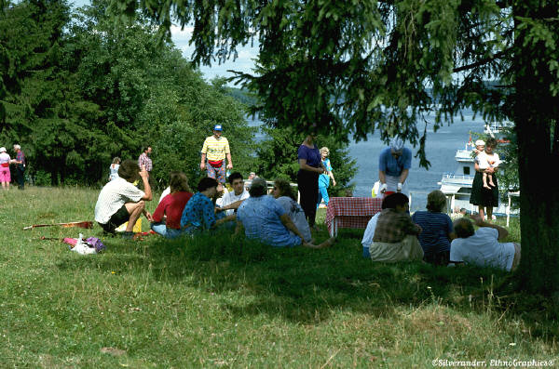
Unique Features of FGDM
Emphasis is on strengths
Strengths are the tools to solve concerns
Communicating in a language of concerns
Addressing problems in a different way that might minimize arguing and fighting
Making the family the primary decision-maker

Slide 14
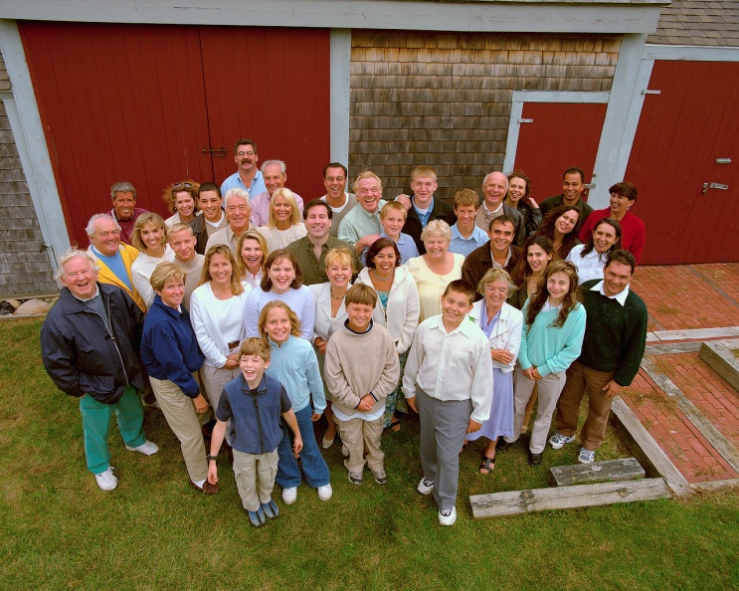
Unique Features of FGDM
An extensive family gathering
The Family:
Defines who family is
Decides who attends
Reaches out to all who care
Identifies positive supportive resources
Chooses the site at which to hold the meeting
Not an agency meeting

Slide 15
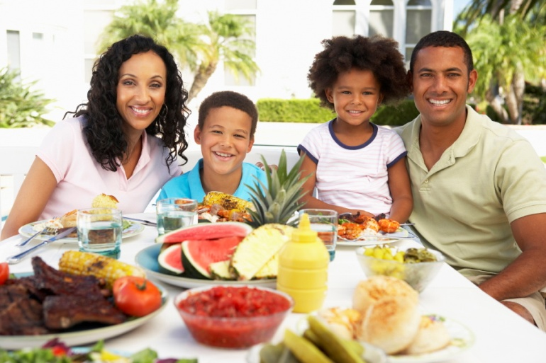
Unique Features of FGDM
FGDM is transformational because it:
Is not a program, it is a process
Challenges dominant practices
Requires building partnerships
Is a practice/way of thinking

Slide 16
Section III: Family Group Decision Making Values, Beliefs, and Benefits

Slide 17
The Values and Beliefs of FGDM
Families have strengths and can change
Strengths resolve concerns
Strengths are discovered through listening, noticing, and paying attention to people (Graber, L. & Nice, J., 1997)
Family members are the primary decision makers for their family
FGDM teams work toward empowering families
Families know family best
Families are the experts

Slide 18
The Values and Beliefs of FGDM
Children are best raised by their families
Families should be respected
Mistakes are opportunities for growth and development
All families are invested in seeing their children safe and successful
All families have the ability to come together and solve family concerns
All families have some resources they can count on to help them in times of need
Families should choose which relatives, friends, and providers will attend their conference

Slide 19
Benefits of FGDM
What do you believe are likely benefits of FGDM?

Slide 20
FGDM in Pennsylvania
Pennsylvania Family Group Decision Making (FGDM) Leadership Team remains committed to the evaluation of FGDM statewide
In 2005, the FGDM Leadership Group began efforts to evaluate the implementation and impact of FGDM in Pennsylvania
The FGDM evaluation committee leads this work and the Resource Center implements the evaluation
Participation in the evaluation is voluntary and can vary from year to year

Slide 21
FGDM in Pennsylvania Cont.
The evaluation captures an array of information regarding the FGDM practice
Evaluation focuses on:
Participants’ experiences with FGDM
Adherence to the FGDM model
Impact on child outcomes

Slide 22
Section IV: The Family Group Decision Making Process

Slide 23
FGDM Practice
Strength-Based
Safety
Permanence
Well-Being
Collaborative
Family-Driven
Culturally Appropriate
(Statewide FGDM Evaluation, 2015)

Slide 24
Stacking for Success
6: Are you willing to help the family with follow up?
**Adapted from J. Nice, Family Unity Project
Design by P. Evans
5: Are you willing to attend the meeting and consider the family plan?
4: Can the people invited accomplish the purpose?
3: Is the purpose clear and understandable? Does it motivate everyone to attend?
2: Is the family voluntarily participating and have they agreed to participate in the FGDM process?
1: Do you have hope for the family? Do you believe the family has the ability to come together and be successful in creating a family plan?

Slide 25
Presenting FGDM to Families
Briefly describe the practice. In doing so:
Reinforce the agency’s belief in family ownership/empowerment
Reinforce the emphasis the agency places on the family’s voice in decision making
Secure consents to release information
Discuss the potential purpose/participants for the FGDM meeting
Connect the family with the FGDM Coordinator

Slide 26
A Purpose Statement Should…
Address safety, permanency, well-being, and/or balanced and restorative justice
Motivate everybody to attend
Be significant enough to have all the family invested in attending
Be mutually agreed upon by all who attend the meeting
Be clear and understandable

Slide 27
Pre-Conference
Held prior to the FGDM meeting
Involves FGDM staff and Service Providers
Purpose is to discuss the purpose/goals of the FGDM meeting and any safety concerns
Typical Agenda for an FGDM Pre-Conference Involves:
Introductions
Explaining the paradigm shift
Discussing the roles
Reviewing the purpose
A brief overview
Discussing strengths
Discussing concerns:
Familial
Bottom-line
Identifying resources

Slide 28
Who Attends FGDM Conferences?
Both natural and professional supports attend FGDM conferences. Natural supports may include biological parents, step parents, relatives, children, and youth.
Professional supports may include child welfare professionals, JPO, school professionals, and behavioral health providers.
Based on the family driven nature of FGDM, it is preferable for there to be more natural supports than professional supports.
(Statewide FGDM Evaluation, 2015)

Slide 29
Phase 1: Welcome & Introductions
Family Ritual
Roles
Purpose
Guidelines

Slide 30
Phase 2: Information Sharing
Strengths
Concerns
Family Concerns
Bottom-Line Concerns
Resources

Slide 31
Phase 3: Private Family Time

Slide 32
Keys to Successful Private Family Time
The facilitator will ensure that:
the family understands the expectations of Private Family Time
the privacy of the room is maintained
providers do not discuss the family outside of the room
service providers know they are free to leave the conference (except for the referral source)
service providers know they will receive a copy of the plan

Slide 33
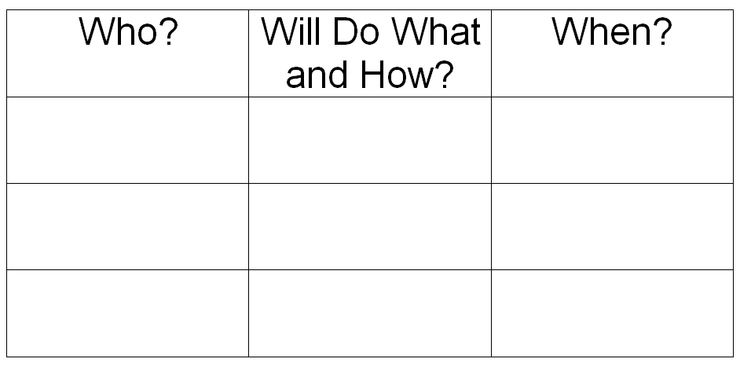
Plan Documentation
Concern (The “Why?”)
(June Fisher, MSW, 2011. Used with Permission.)

Slide 34
Phase 4:
Presentation of Family Plan and Acceptance
Family Ritual
Conclusion

Slide 35
Section V: Wrap-up and Evaluation

Slide 36
Best Practice FGDM Implementation
The essential components of Pennsylvania’s FGDM model consist of:
Hope for the family
Family decision making in the planning
Safety for everyone
Voluntary practice
Cultural competence
Trained neutral coordinators and facilitators
Use of a neutral venue
Adequate preparation for all those involved

Slide 37
Best Practice FGDM Implementation
The following steps must occur in the implementation of Family Group Decision Making:
Coordination and Preparation for the family
Pre-Conference meetings
Sharing of strengths
Sharing of concerns
Offering resource options
Coaching family for Private Family Time
Allowing for mealtime
Private Family Time
Evaluation
Follow-up

Slide 38
Best Practice FGDM Implementation
The following items are flexible in the implementation of FGDM:
How workers express hope for the family
How the Pre-Conference meeting proceeds (referring worker, service provider, facilitator)
Who facilitates meetings (coordinator or facilitator)
How you ensure safety
Specific location
How to facilitate a strengths discussion
How to facilitate a concerns discussion
Mealtime menu, time, participants
How to offer resource options
How follow-up occurs
How to conduct the evaluation

Slide 39
Questions and Answers

